Slide 1

HOSPITAL MANAGEMENT SYSTEM
BY SURAJ NAVNATH KORDE & SIDDHESH DINESH DALVI

Slide 2


CONTENTS OF THIS PROJECT
INTRODUCTION
SURVEY OF TECHNOLOGY
REQUIREMENTS AND ANALYSIS
SYSTEM DESIGN.
CONCLUSIONS.

Slide 3



Introduction
The project Hospital Management system includes registration of patients, storing their details into the system, and also computerized billing in the pharmacy, and labs.
User can search availability of a doctor and the details of a patient using the id.
Hospitals Management System enables you to develop your organization and improve it effectiveness and quality of work.

Slide 4
1.1 BACKGROUND
A Hospital is a place where Patients come up for general diseases. Hospitals provide facilities like.
Consultation by Doctors on Diseases.
Diagnosis for diseases.
Providing treatment facility.
Facility for admitting Patients (providing beds, nursing, medicines etc.)
Immunization for Patients/Children. Various operational works that are done in a Hospital.
Recording information about the Patients that come.
Generating bills.
Recording information related to diagnosis given to Patients.

Slide 5
PURPOSE
The health system is one of essential socio-economic activities; therefore, it requires rational and effective management. For this, it is necessary to have a tool that allows adequate control of the information generated in health institutions.
Hospital management systems allows us the ability to optimize and digitize all the processes within the institution, which will help to improve customer service, reduce process costs, streamline the search of medical records, bills, patients, doctors, etc.; thus, having a database of each module implemented.
A hospital management system is a web system developed for companies that wish to manage their processes, implementing modules for each of the required areas.
Computer technology is only a tool that allows us to perfect the inveterate use of paper records (notebooks, index cards, diaries, bibliographies, record books), or more recently, cassettes or video cassettes. A PC only collects and processes data; it is the individual that acquires information.

Slide 6
OBJECTIVE
Hospital management System handles activities of major departments in a hospital like:
Doctor Management
Define hospital
Recording information about the Patients that come.
Generating bills
Recording information related to diagnosis given to Patients.
Patient management (scheduling, registration and long-term care)
Patient care management and department Management.

Slide 7
ALORITHMS DESIGN
STEP 1: START.
STEP 2: OPEN REGISTRATION PAGE.
STEP 3: ALLOCATE MEMORY FOR NEW PATIENT INFORMATION.
STEP 4: ENTER INFORMATION.
STEP 5: CREATE UNIQUE PATIENT ID.
STEP 6: CREATE USERNAME AND PASSWORD.
STEP 7: CREATE ENTRY TO THE DATABASE.
STEP 8: ALLOCATE DOCTOR FOR THE PATIENT.
STEP 9: TESTS AND REPORTS ENTRY.
STEP 10: INITIATE ADVANCE FEES.
STEP 11: ALLOCATION OF BED AND ROOM FOR PATIENT.
STEP 12: PATIENT HEALTH PROGRESS.
STEP 13: PATIENT DISCHARGE.
STEP 14: PENDING FEES AND UPDATION.
STEP 15: END.

Slide 8
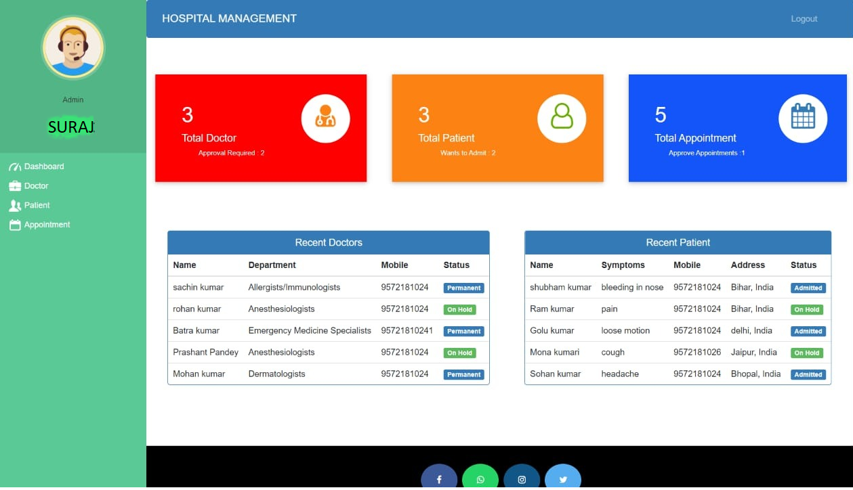
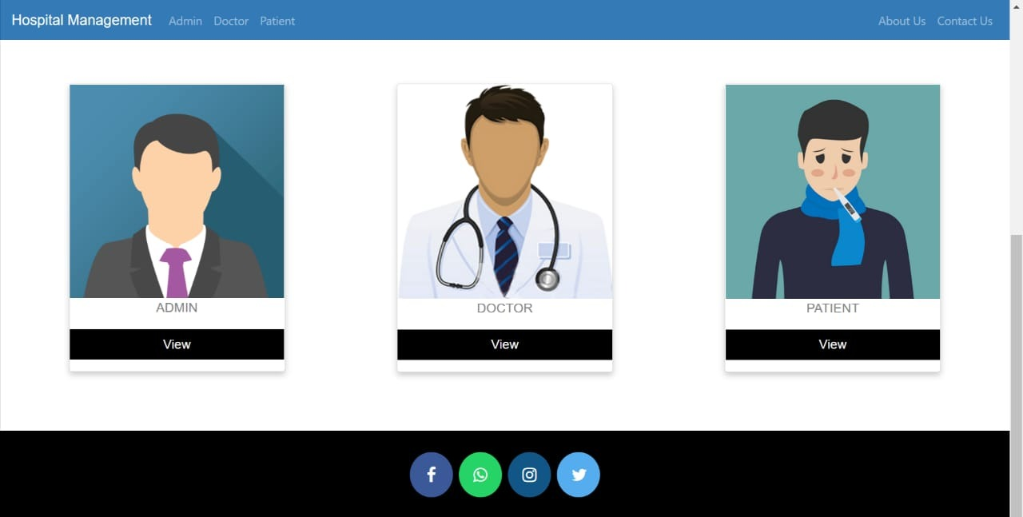
USER INTERFACE DESIGN
Homepage
Admin Dashboard

Slide 9
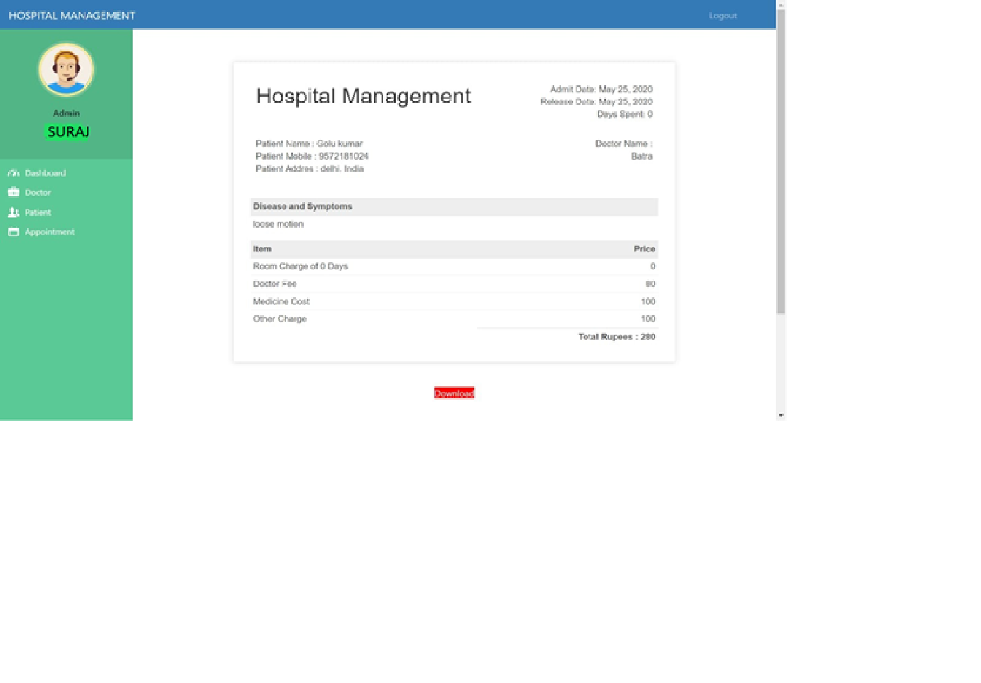
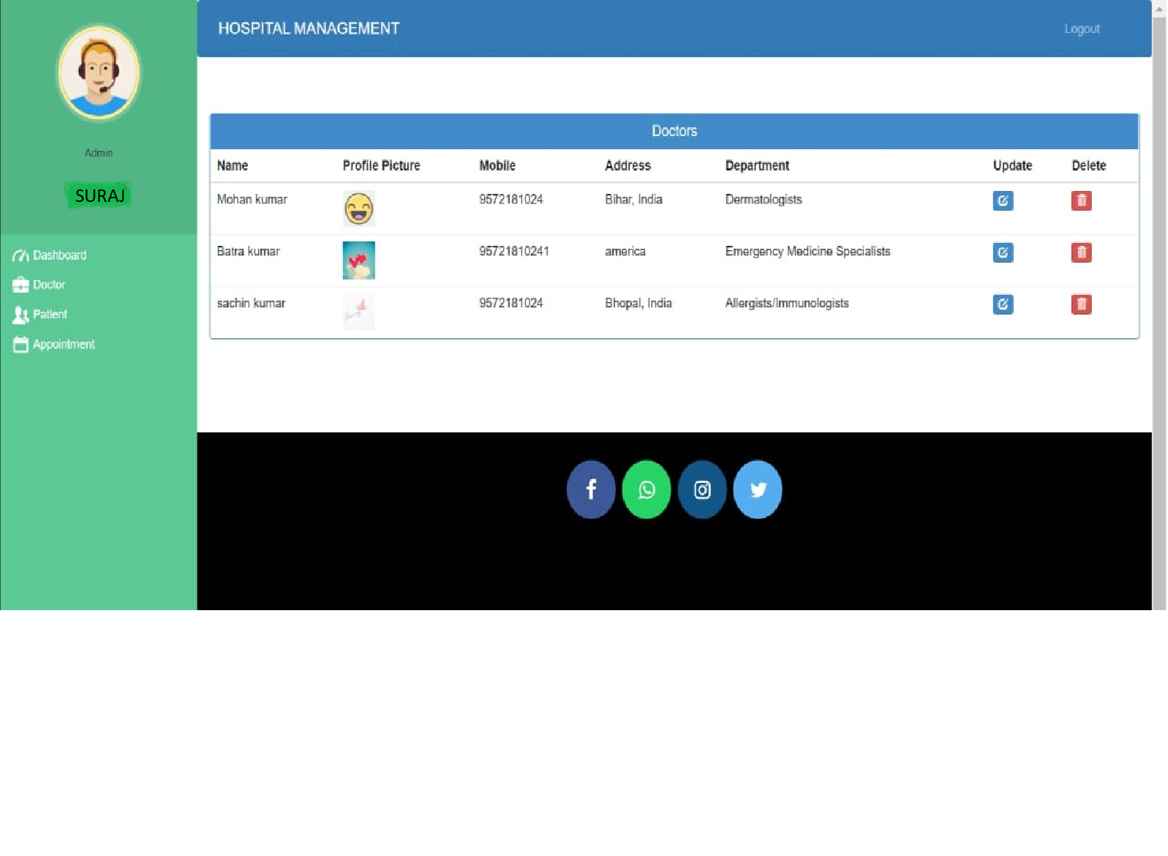
USER INTERFACE DESIGN
Invoice
Doctor list

Slide 10
SURVEY OF TECHNOLOGY
CHAPTER NO. 2

Slide 11
PROPOSED SYSTEM
The Hospital Management System is designed for any hospital to replace their existing manual paper-based system. The new system is to control the information of patients. Room availability, staff and operating room schedules and patient invoices. These services are to be provided in an efficient, cost effective manner, with the goal of reducing the time and resources currently required for such tasks.

Slide 12
REQUIREMENT ANALYSIS
In this paper we present designs of four such agents. They are: Patient Agent, Doctor Agent, Nurse Agent and Environment Agent.
Patient Agent:
A patient agent simulates the role of patients. The agent helps patients in consultancy about doctor selection according to his need and symptoms. The agent gathers patient’s requirements and prepares a requirement report in the developers’ comprehensible form and sends that to him.
Doctor Agent:
A doctor agent plays the role of a doctor. It’s the main aim is to gather requirements of the doctor such as time saving approaches to deal with the patient and prepare report for developer. A doctor agent also collects the advisory requirements such as suitable treatment and medication for a particular patient.
Environment Agent:
The environment agent is responsible for the hospitality of the hospital. It maintains the arrangement of various hospital units such as wardrooms, ICUs and operating rooms. It is the part of user interface of the computerized HMS. An environment agent senses requirements related to user interface of the HMS software and helps doctors and patients in the selection of various hospital resources such as ICUs, operating rooms, and wardrooms.

Slide 13
HARDWARE REQUIREMENTS & SOFTWARE REQUIREMENTS
HARDWARE REQUIREMENTS
SOFTWARE REQUIREMENTS
The most common set of requirements defined by any operating system or software application is the physical computer resources, also known as hardware.
HARDWARE REQUIREMENTS FOR PRESENT PROJECT:
PROCESSOR: Intel dual Core, I3
RAM: 1 GB
HARD DISK: 80 GB
Software Requirements deal with defining software resource requirements and pre-requisites that need to be installed on a computer to provide optimal functioning of an application.
These requirements or pre-requisites are generally not included in the software installation package and need to be installed separately before the software is installed

Slide 14
JUSTIFICATION OF SELECTION OF TECHNOLOGY
If you are ready to implement or go with the hospital management system, make sure you follow these things before making it useful in your hospitals or labs.
Processing Speed & Results
Cost Effective
Reduction in Errors
Data Security & Retrieving Ability
Improved Patient Care
Quality & Compliance

Slide 15
REQUIREMENTS AND ANALYSIS
CHAPTER NO .3

Slide 16
MODULE DIVISION
1- Patient Management System:
Hospital Management System developed by Solution Dots Systems provides complete assistance in patient management. In the module of the patient management system, there is a facility to register patients and view their reports and history.
2- Doctor Management System:
Doctor Management System allows registering the doctors, working in a hospital as well as their clinic details.
3- Administrative Rights Management System:
Administrative Rights Management System includes all right of management including HR and administration.
4- Online Appointment Management System:
Online Appointment Management System allows getting online appointment instead of physical visit.
5- Invoice System:
After the appointment confirmation Invoice System generates an automatic invoice against that specific patient, this invoice helps to know about the current status of payment as well as complete payment.
6- Medical Services System:
Medical Services System allows adding a list of services that are provided by the hospital such as dental treatment service, cardiac services, mental treatment services, bones treatment services and much more.

Slide 17
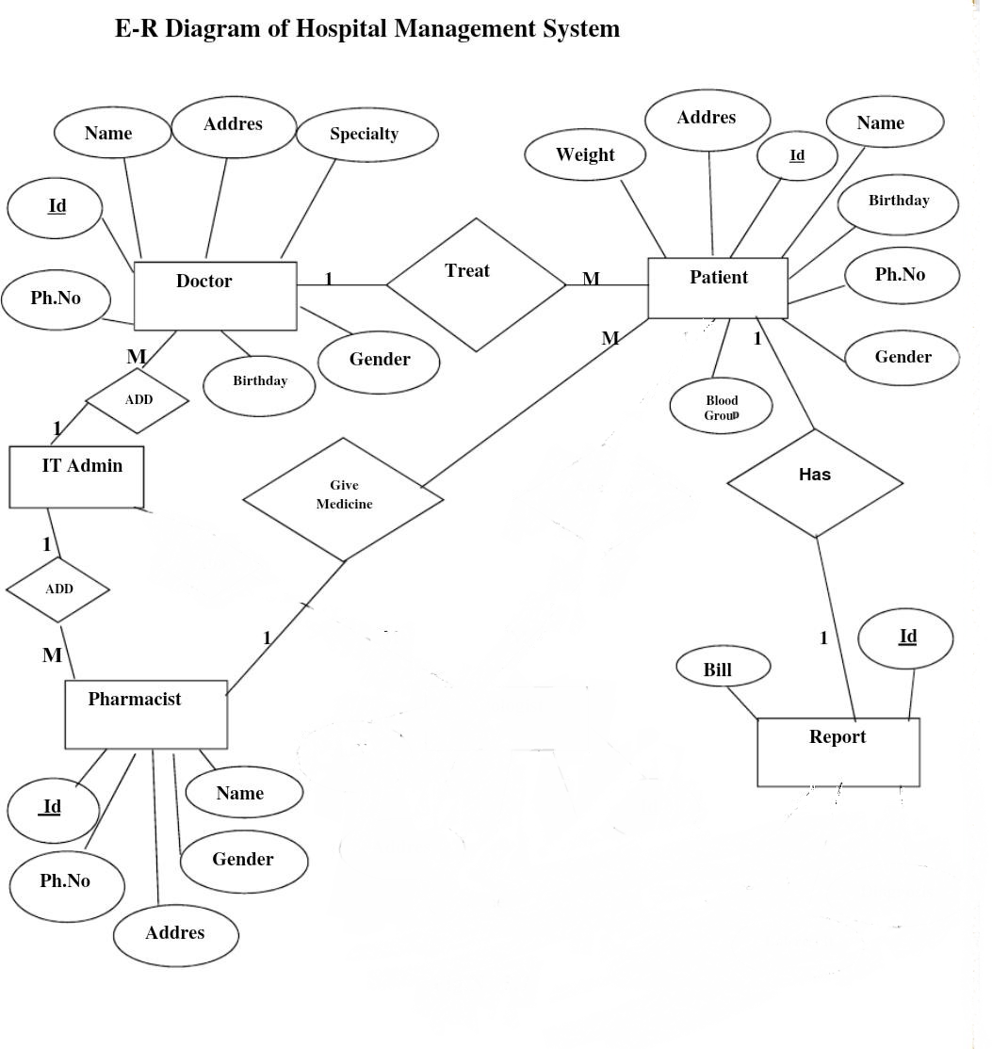
Entity-Relationship Diagram (E-R)

Slide 18
SYSTEM DESIGN
CHAPTER NO 4

Slide 19
DATA DESIGN
Data types and its description:
Fields in database table have a data type. Some of the data types used in database table are explained below.
A) Integer: -
One optional sign character (+ or -) followed by at least one digit (0-9). Leading and trailing blanks are ignored. No other character is allowed.
B) Varchar: -
It is used to store alpha numeric characters. In this data type we can set the maximum number of characters up to 8000 ranges by default SQL server will set the size to 50 characters large.
C) Date/Time: -
Date/Time data type is used for representing data or time.

Slide 20




CONCLUSION
In Conclusion, from a proper analysis and assessment of the designed system, it can be safely conclude that the system is an efficient, usable and reliable records management system. It is working properly and adequately meets the minimum expectations that were set for it initially. The new system is expected to give benefits increased overall productivity, performance and efficient records management.

Slide 21

Thank you

